Slide 1



Executive Summary DHL Group
Contracts
Supplier Management+
Sourcing+
What’s working:
Improvement Opportunities:
Stable usage of the system in Sourcing+
Creation method (from template and RFx) in RFQ shows good user adoption
Sourcing events award % is major opportunity to improve (<20%)
Opportunity to upgrade overall SRM approach (process, internal & external data sources, execution/impact)​
Start evaluation and integration of Risk and ESG data​
Create 360 supplier view based on internal & external data
Contracts Management: Increase Usage

Slide 2
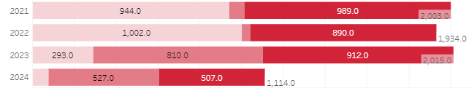
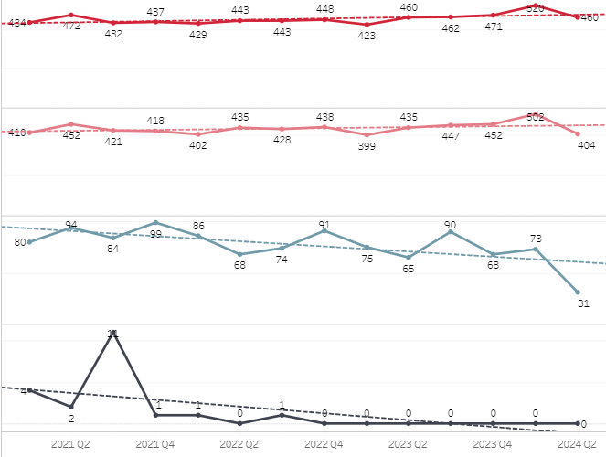
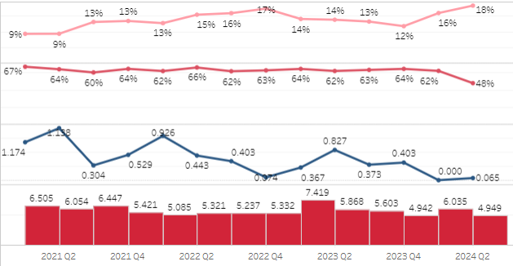
Sourcing+ Source: Jaggaer Analytics
How are users creating RFX?
+ 4 % of events
between 2022 & 2023
+ 1800% of events
Created from template
Focus on Request for Quotation
Invited vs Bidders
Take away
Template usage increased significantly
Usage of creation methods (from template or from RFx) shows good user adoption
Opportunity to improve the number of awarded events in the system (<18%)
Opportunity to increase competitiveness: Approx. 14% of the events have only 1 supplier
Standard participations rate: 62% supplier bidder

Slide 3
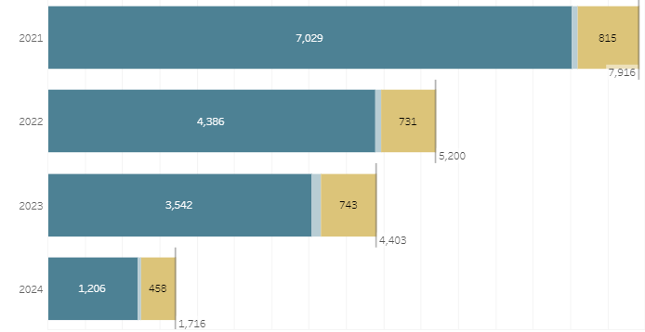
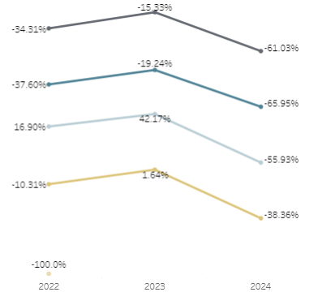
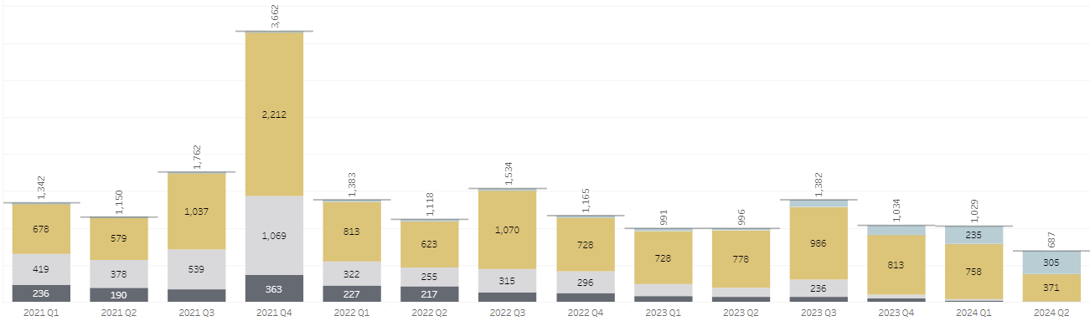

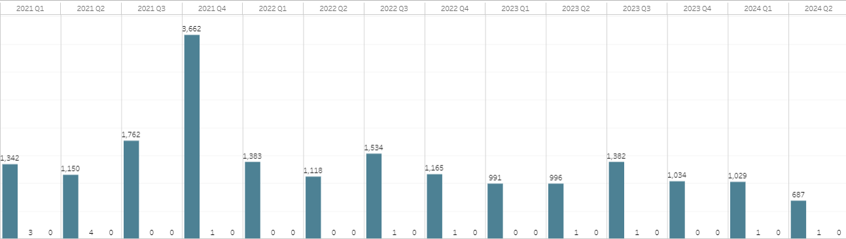

Contract Source: Jaggaer Analytics
Volume & Share of created contracts YoY change
Take away
Number of contracts decreasing by 15%
good usage of templates
No usage of digital signature or MCD due to missing functionalities (already discussed)
Nb & Share of created contracts by status
% of created contracts with a MCD & digitally signed

Slide 4
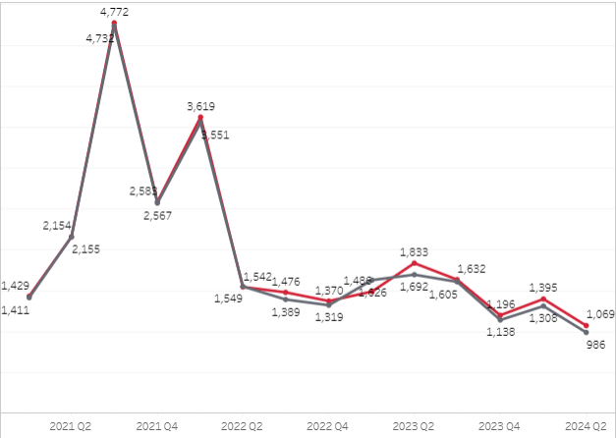
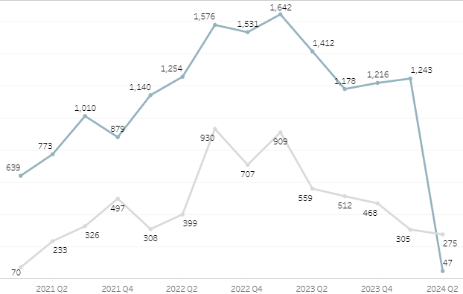


Supplier Management Source: Jaggaer Analytics
Registered and enabled suppliers
Supplier Evaluated and Qualified

Slide 5
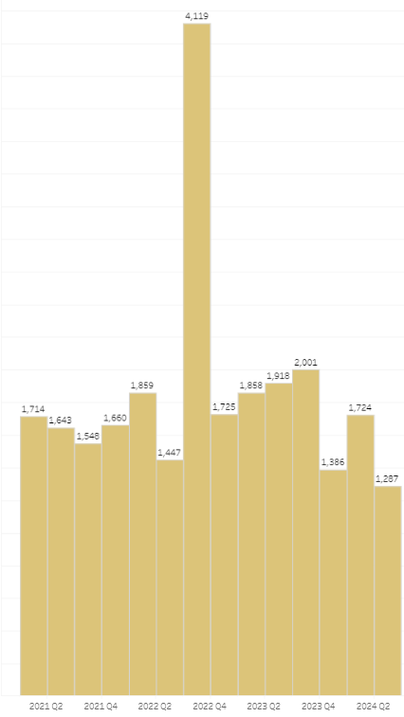
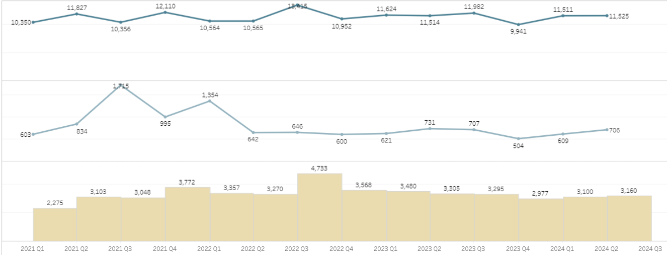

Supplier Management Source: Jaggaer Analytics
Suppliers with at least 1 category
Supplier Number of Logins and Unique Users

Slide 6
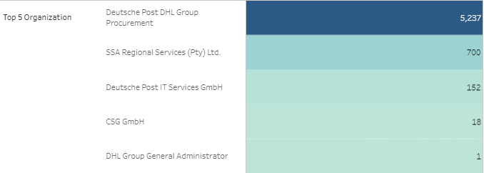
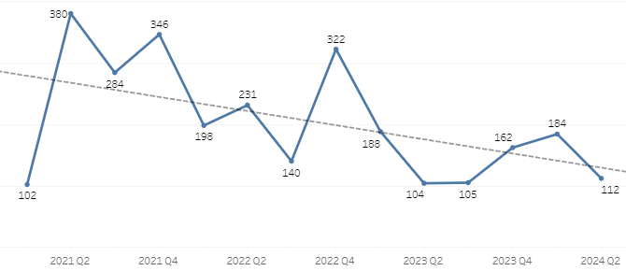
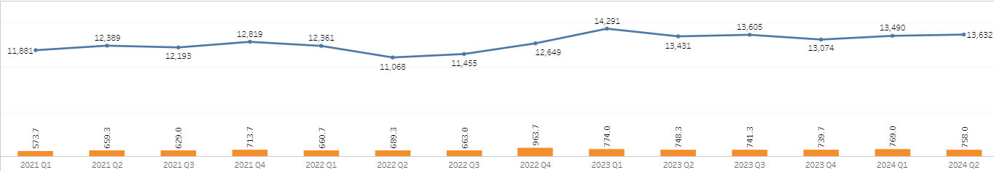

Users Source: Jaggaer Analytics
Active users
Active Users per Division
6109
Registered users trend
Number of logins and unique users logins

Slide 7
JAGGAER Solution Resources
JAGGAER University
JAGGAER Solution Information & Training Courses including certifications.
JAGGAER Product Release Library
Major Release & Maintenance Release Information
Online Searchable Help
Use Keywords to search the online help system
Online Solution Handbooks
PDF Handbooks for common features and processes for JAGGAER modules.

